Slide 1
Long Short-Term Memory Recurrent Neural Network for Remaining Useful Life Prediction of Lithium-Ion Batteries
Haejoong Lee
Sogang University, EE
2021.01.08

Slide 2
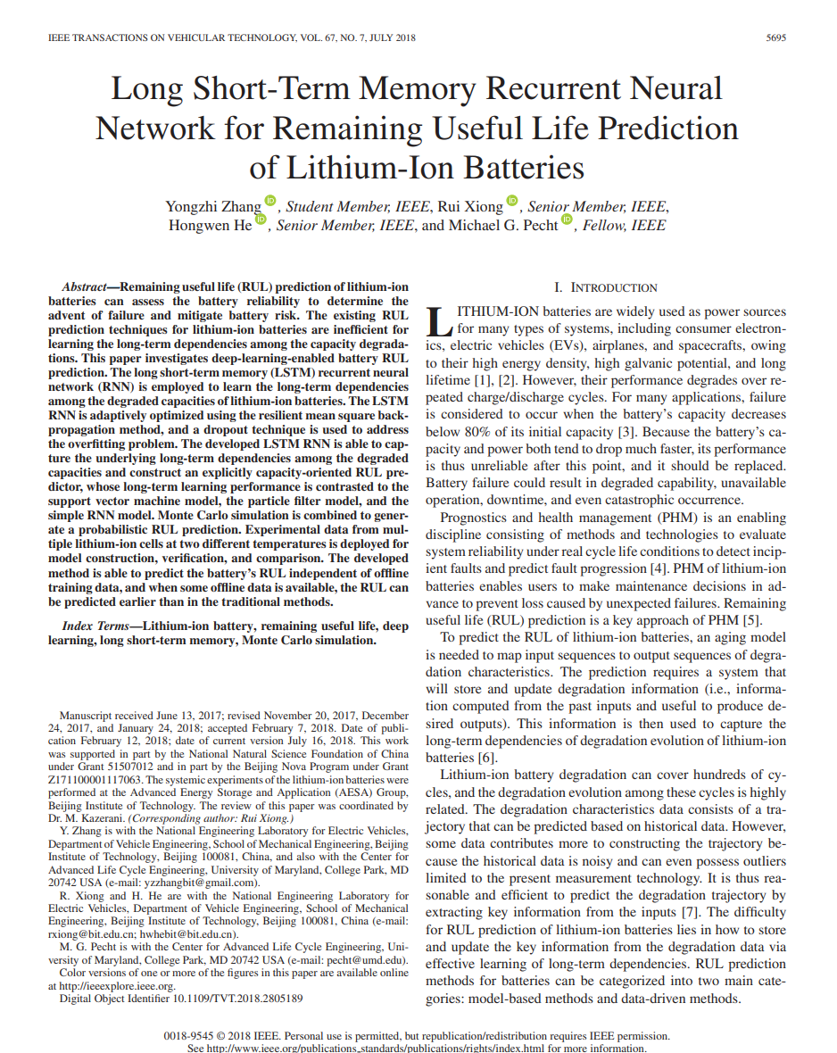
Long Short-Term Memory Recurrent Neural Network for Remaining Useful Life Prediction of Lithium-Ion Batteries
Contents
INTRODUCTION
BATTERY TESTING AND DEGRADATION DATA
LSTM-RNN-ORIENTED RUL PREDICTION
Dropout to Prevent LSTM RNN From Overfitting
RUL Prediction Without Offline Training Data
RUL Prediction With Some Offline Training Data
Monte Carlo Simulation
RESULTS AND DISCUSSION
CONCLUSIONS
[IEEE TRANSACTIONS ON VEHICULAR TECHNOLOGY, VOL. 67, NO. 7, JULY 2018]
Index Terms – Lithium-ion battery, remaining useful life, deep learning, long short-term memory, Monte Carlo simulation.

Slide 3
Long Short-Term Memory Recurrent Neural Network for Remaining Useful Life Prediction of Lithium-Ion Batteries
Abstract
Remaining useful life (RUL) prediction of lithium-ion batteries can assess the battery reliability to determine the advent of failure and mitigate battery risk.
The existing RUL prediction techniques for lithium-ion batteries are inefficient for learning the long-term dependencies among the capacity degradations.
This paper investigates deep-learning-enabled battery RUL prediction.
The long short-term memory (LSTM) recurrent neural network (RNN) is employed to learn the long-term dependencies among the degraded capacities of lithium-ion batteries.
The LSTM RNN is adaptively optimized using the resilient mean square backpropagation method, and a dropout technique is used to address the overfitting problem.

Slide 4
Long Short-Term Memory Recurrent Neural Network for Remaining Useful Life Prediction of Lithium-Ion Batteries
Abstract
The developed LSTM RNN is able to capture the underlying long-term dependencies among the degraded capacities and construct an explicitly capacity-oriented RUL predictor, whose long-term learning performance is contrasted to the support vector machine model, the particle filter model, and the simple RNN model.
Monte Carlo simulation is combined to generate a probabilistic RUL prediction.
Experimental data from multiple lithium-ion cells at two different temperatures is deployed for model construction, verification, and comparison.
The developed method is able to predict the battery’s RUL independent of offline training data, and when some offline data is available, the RUL can be predicted earlier than in the traditional methods.

Slide 5
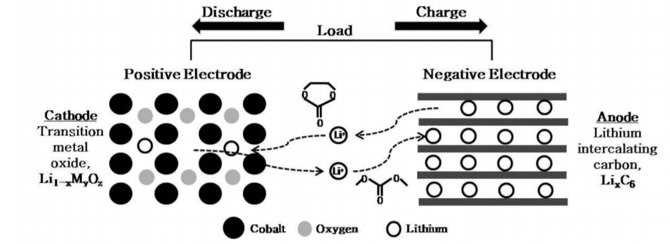
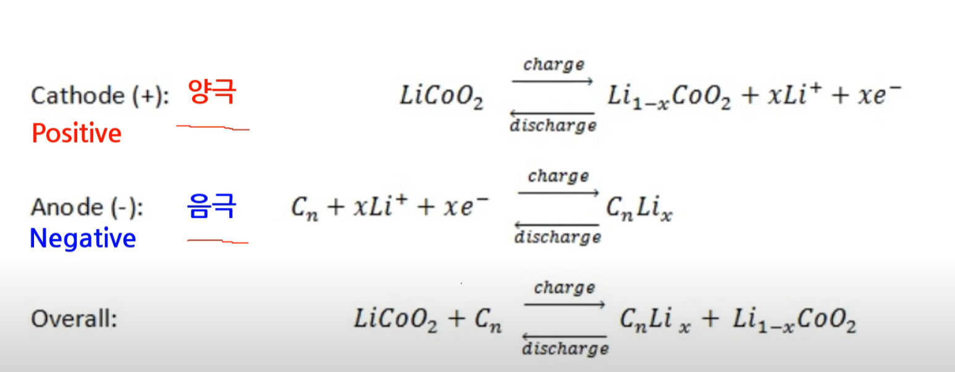
Long Short-Term Memory Recurrent Neural Network for Remaining Useful Life Prediction of Lithium-Ion Batteries
Introduction
Four major components of secondary battery
양극재 : 양이온(e.g. Li, Ni), 소스로 배터리의 용량과 평균 전압을 결정
음극재 : 양극에서 나온 양이온을 저장했다가 방출하면서 회로를 통해 전류를 흐르게 함
분리막 : 양극과 음극의 접촉을 차단하는 역할
전해액 : 이온이 원활하게 이동하도록 돕는 매개체
<리튬 이온, 2차 전지 구조>
<리튬 이온, 2차 전지 원리>
Use case
consumer electronics, electric vehicles (EVs), airplanes, and spacecrafts, owing
to their high energy density, high galvanic potential, and long lifetime
2차 전지 : secondary cell, storage battery, rechargeable battery

Slide 6
Long Short-Term Memory Recurrent Neural Network for Remaining Useful Life Prediction of Lithium-Ion Batteries
Introduction
Battery Failure is considered to occur when the battery’s capacity decreases below 80% of its initial capacity
Battery failure could result in degraded capability, unavailable operation, downtime, and even catastrophic occurrence.
Lithium-ion battery degradation can cover hundreds of cycles, and the degradation evolution among these cycles is highly related.
The degradation characteristics data consists of a trajectory that can be predicted based on historical data.
However, some data contributes more to constructing the trajectory because the historical data is noisy and can even possess outliers limited to the present measurement technology.
It is thus reasonable and efficient to predict the degradation trajectory by extracting key information from the inputs.
PHM (Prognostics and health management)

Slide 7
Long Short-Term Memory Recurrent Neural Network for Remaining Useful Life Prediction of Lithium-Ion Batteries
Introduction
model-based methods : to capture the long-term dependencies of battery degradations
PF (Particle Filter) algorithm
DST (Dempster-Shafer theory)
Ensemble model
AIC (Akaike information criterion)
PF framework
IMMPF (Interacting multiple model particle filter)
data-driven methods : data-driven methods do not need an explicit mathematical model to describe the degradation evolution of batteries and are only dependent on historical degradation data
SVM (support vector machine)
RVM (relevance vector machine)
kernel techniques
NN, RNN, LSTM
drawbacks
No accurate aging model
PF is limited by the particle degeneracy problem
PEVs – Plug-in electric vehicles (PEV)

Slide 8
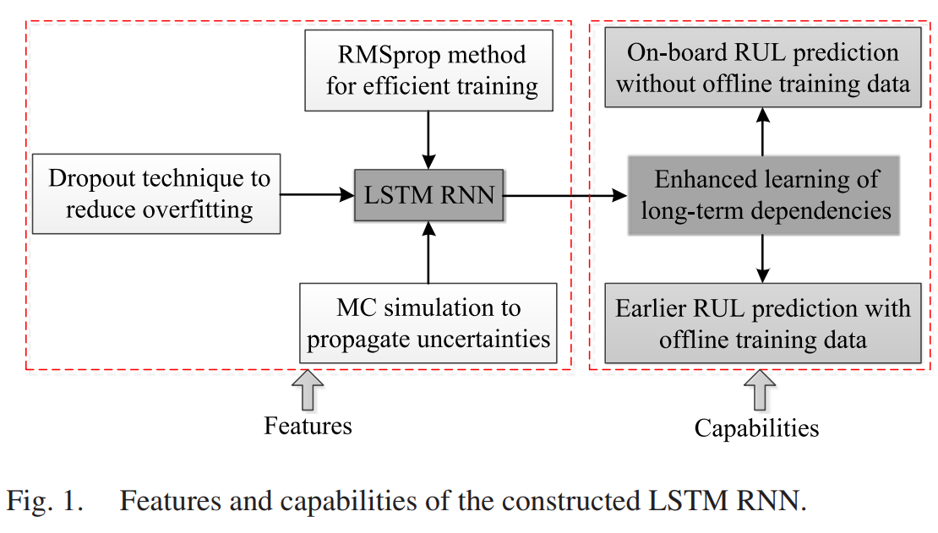
Long Short-Term Memory Recurrent Neural Network for Remaining Useful Life Prediction of Lithium-Ion Batteries
Introduction
RMSprop : the resilient mean square back-propagation
online-data : the data collected in real applications
offline-data : the data collected in the experiments

Slide 9
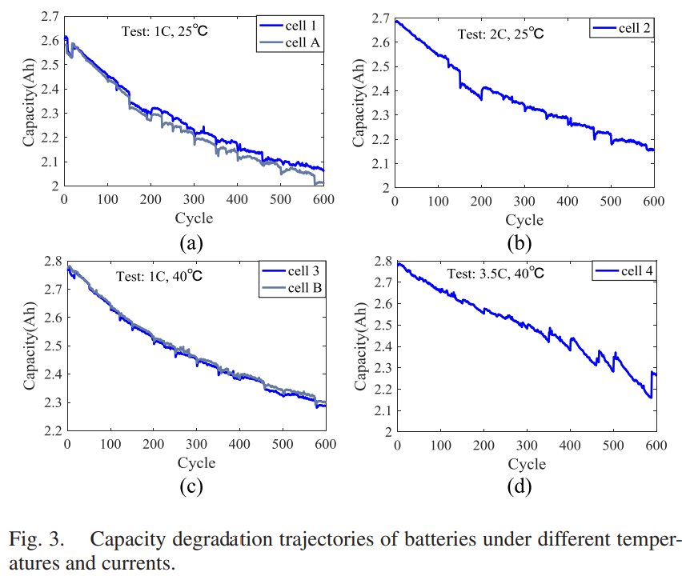
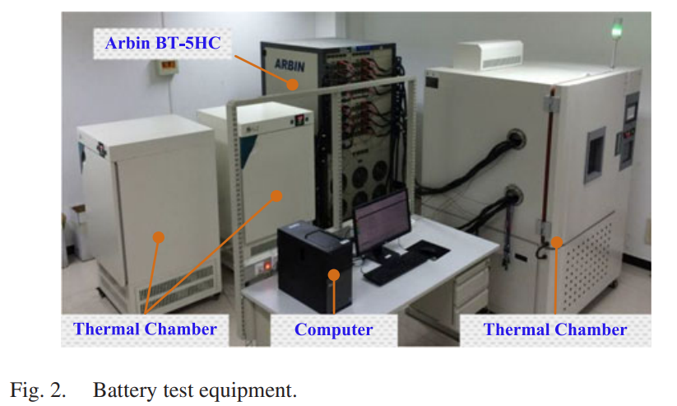
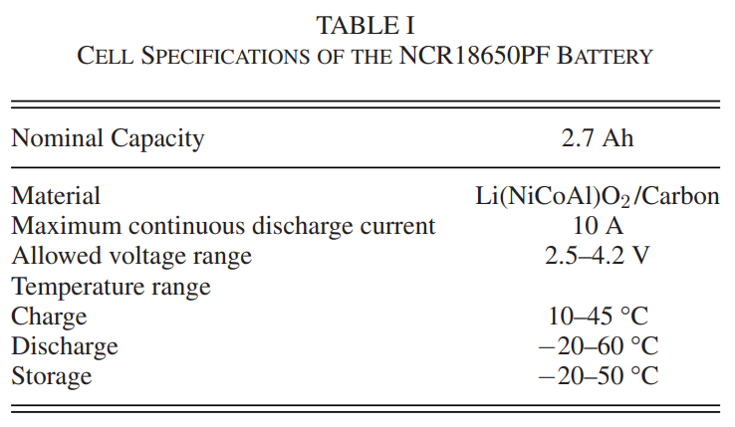
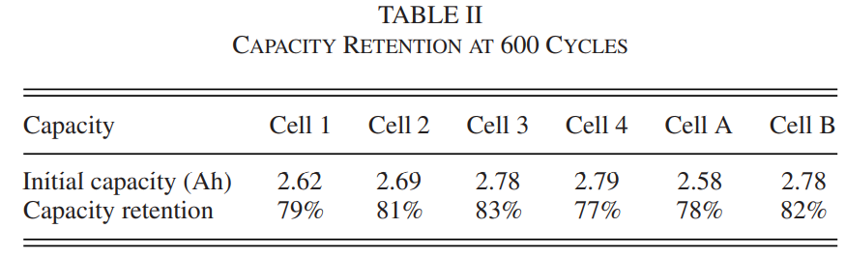
Long Short-Term Memory Recurrent Neural Network for Remaining Useful Life Prediction of Lithium-Ion Batteries
Battery testing and degradation data
“온도” 및 “C-rate”가 Cycle/Capacity에 미치는 영향
C-rate : if 1 C → 1h (discharging/charging)
online-data : the data collected in real applications
offline-data : the data collected in the experiments

Slide 10
Long Short-Term Memory Recurrent Neural Network for Remaining Useful Life Prediction of Lithium-Ion Batteries
LSTM-RNN-Oriented RUL Prediction
There are three concerns.
Traditional training algorithms based on batch gradient descent or stochastic gradient descent for deep-learning networks can be significantly slow to converge to the correct network weights, which are thus not applicable for the purpose of online failure prediction of lithiumion batteries.
Overfitting is a serious problem in deep neural networks like the LSTM RNN.
The maintenance of lithium-ion batteries is based on an RUL probability distribution function (PDF), while LSTM RNN is unable to obtain uncertainties of the RUL predictions.
▶ network parameter optimization using the RMSprop method
▶ a dropout technique to prevent the neural network from overfitting
▶ MC simulation to generate prediction uncertainties

Slide 11
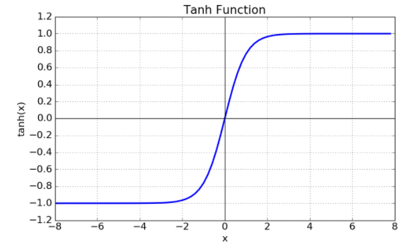
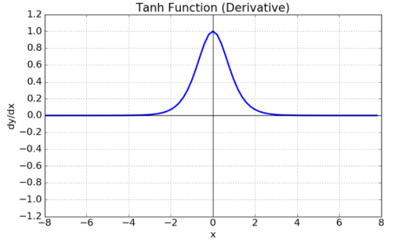
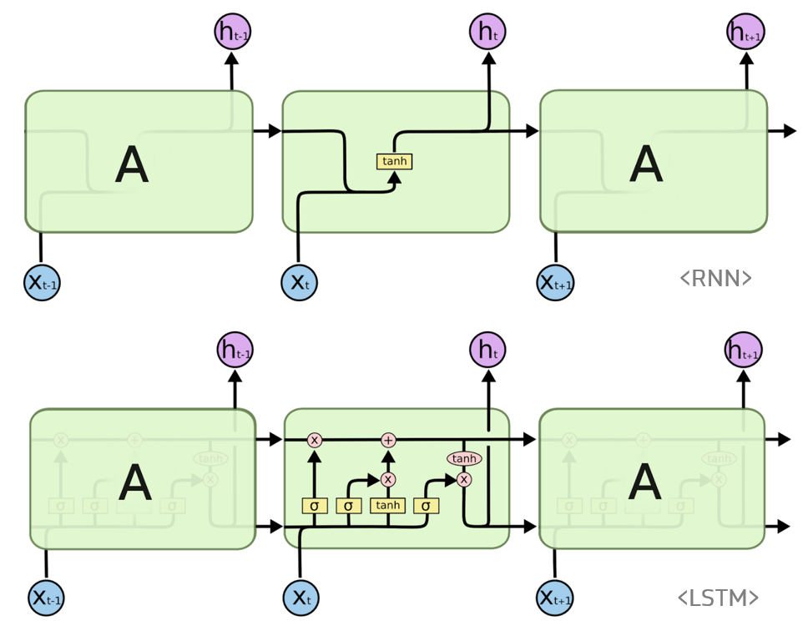
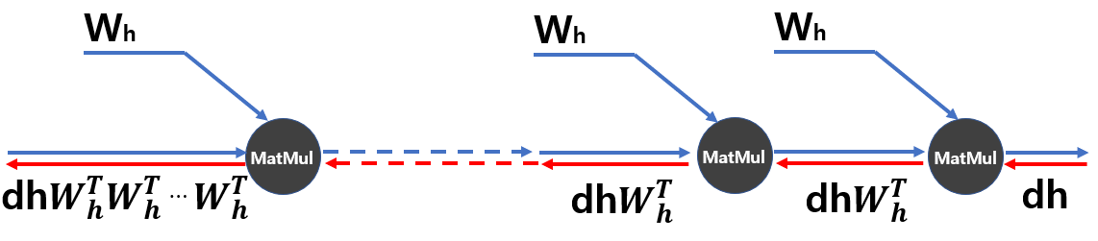
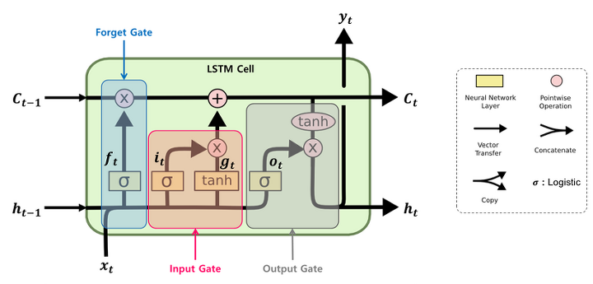
Long Short-Term Memory Recurrent Neural Network for Remaining Useful Life Prediction of Lithium-Ion Batteries
LSTM-RNN-Oriented RUL Prediction
LSTM RNN Architecture
RNN : vanishing gradient problem
I . t$anh function$ 의 특징
II. 행렬 곱에만 주목했을 때의 역전파의 기울기
LSTM Structure
https://colah.github.io/posts/2015-08-Understanding-LSTMs/

Slide 12
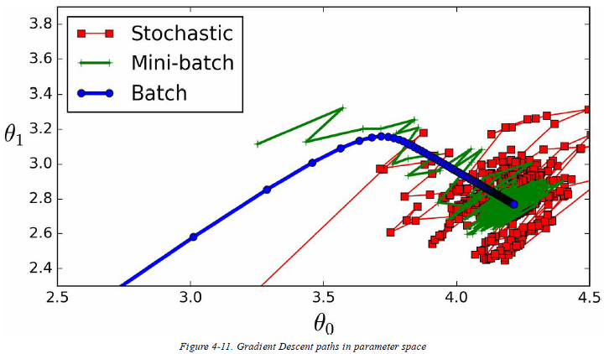
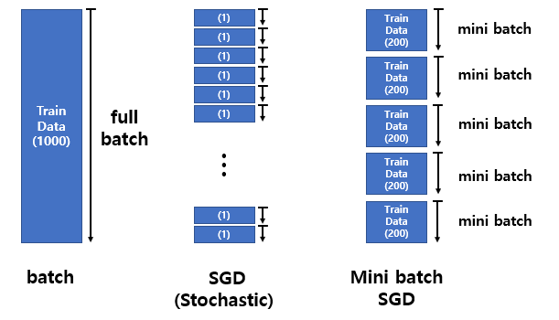

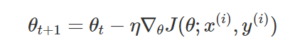
Long Short-Term Memory Recurrent Neural Network for Remaining Useful Life Prediction of Lithium-Ion Batteries
LSTM-RNN-Oriented RUL Prediction
LSTM RNN Training I
slow
variance
local minimum
Unit Tests for Stochastic Optimization

Slide 13
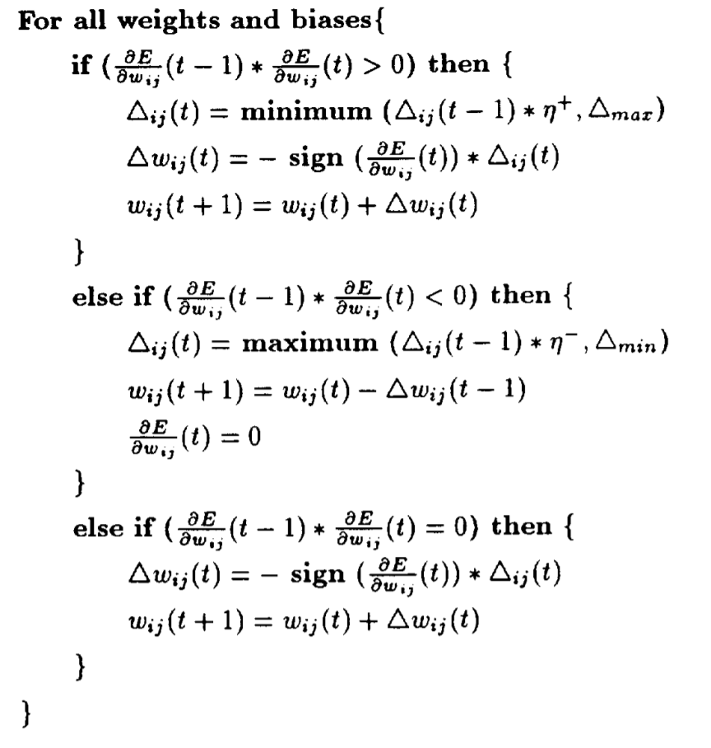
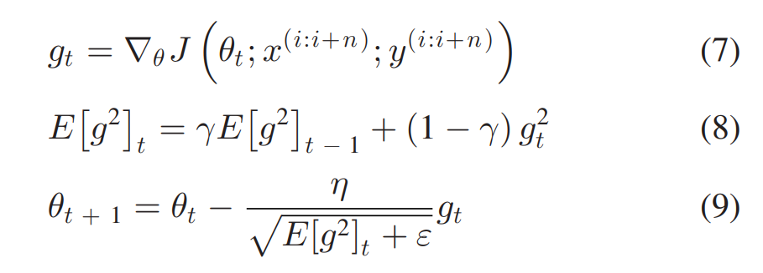
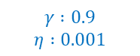
Long Short-Term Memory Recurrent Neural Network for Remaining Useful Life Prediction of Lithium-Ion Batteries
LSTM-RNN-Oriented RUL Prediction
LSTM RNN Training II
Rprop
RMSprop
$$γ :0.9$$
$$η :0.001$$
For batch learning → slow convergence
For Mini-batch learning
Rprop : The resilient back-propagation (Rprop) algorithm
RMSprop : Root Mean Squared Prop

Slide 14
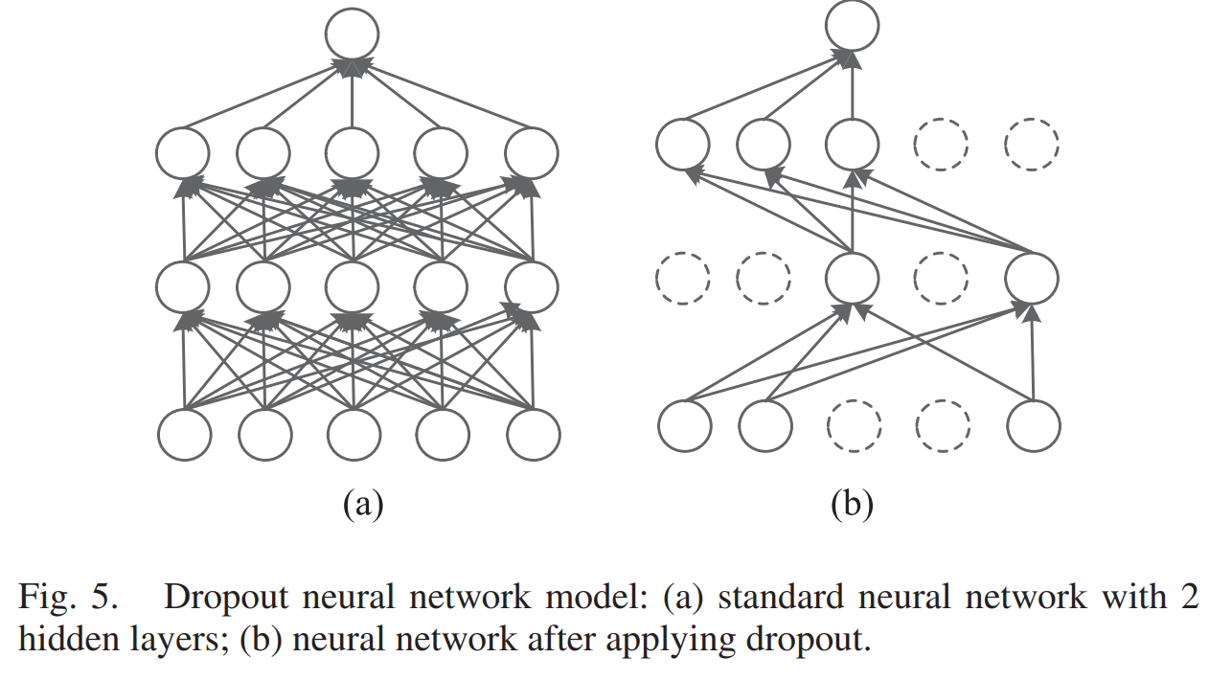
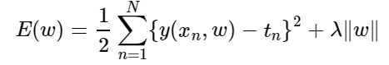
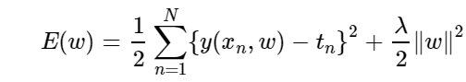

Long Short-Term Memory Recurrent Neural Network for Remaining Useful Life Prediction of Lithium-Ion Batteries
LSTM-RNN-Oriented RUL Prediction
Dropout to Prevent LSTM RNN From Overfitting
L1 Regularization
Dropout
Lasso
L2 Regularization
$$p :0.5 → 0.2$$
Ridge
The network thus becomes less sensitive to the specific weights of neurons.
→ better generalization.

Slide 15
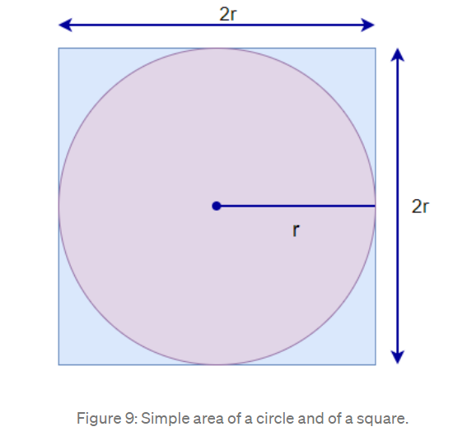
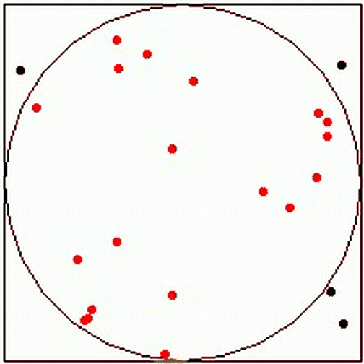
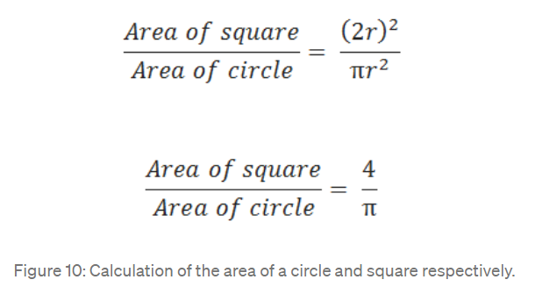
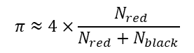
Long Short-Term Memory Recurrent Neural Network for Remaining Useful Life Prediction of Lithium-Ion Batteries
LSTM-RNN-Oriented RUL Prediction
Monte Carlo Simulation
LSTM RNN is unable to provide prediction confidence.
The predicted value and its confidence are both vital parameters to evaluate the performance of a predictor.
The Monte Carlo simulation allows us to see all the possible outcomes of our decisions and assess risk impact, in consequence allowing better decision making under uncertainty.
Estimating PI using circle and square :
Simulation :
$$π≈4×\frac{ N_{red}}{N_{red}+N_{black}}$$
Monte Carlo Simulation An In-depth Tutorial with Python

Slide 16
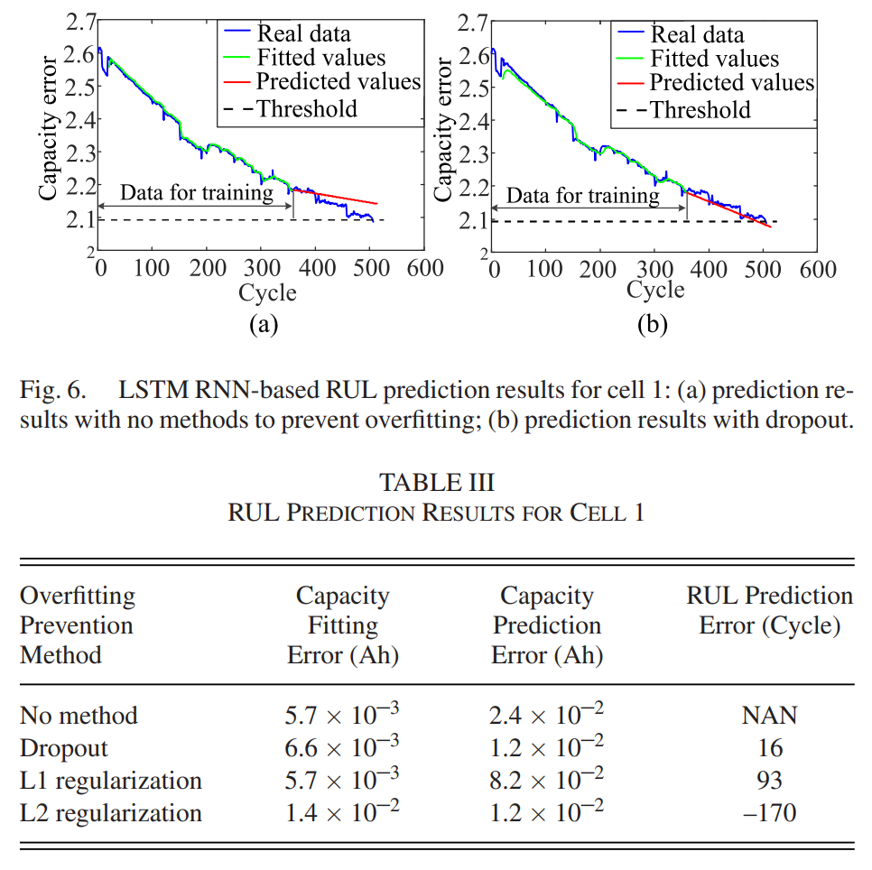
Long Short-Term Memory Recurrent Neural Network for Remaining Useful Life Prediction of Lithium-Ion Batteries
Results and discussion
Dropout to Prevent LSTM RNN From Overfitting
Capacity prediction error
- the mean absolute error between real capacity and fitting or prediction capacity
RUL prediction error
- the error between the real failure cycle and the predicted failure cycle.

Slide 17
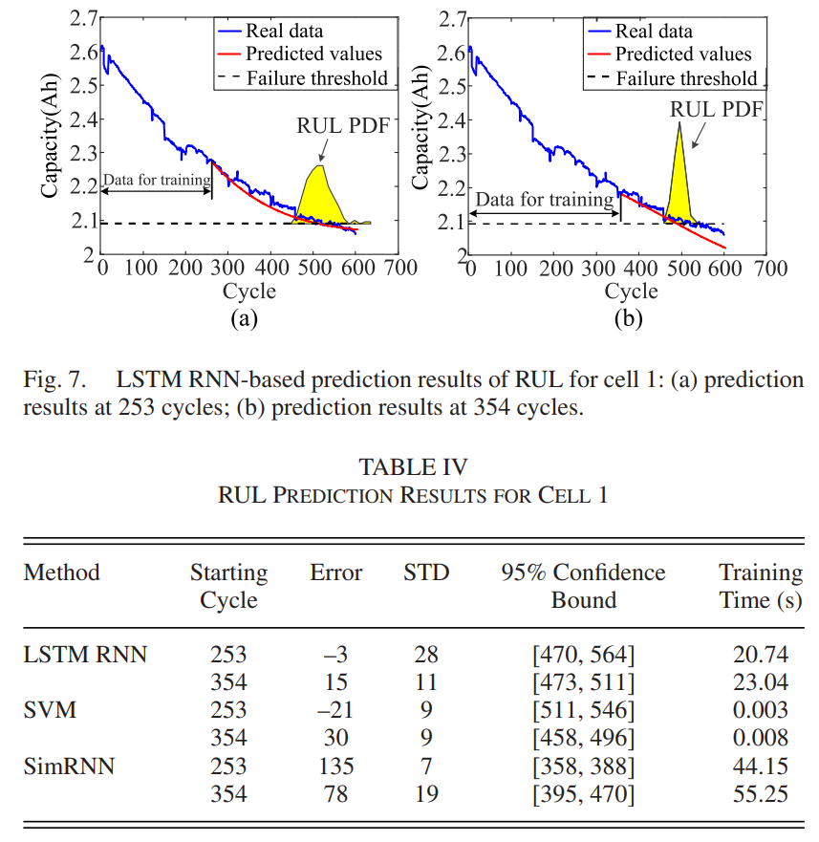
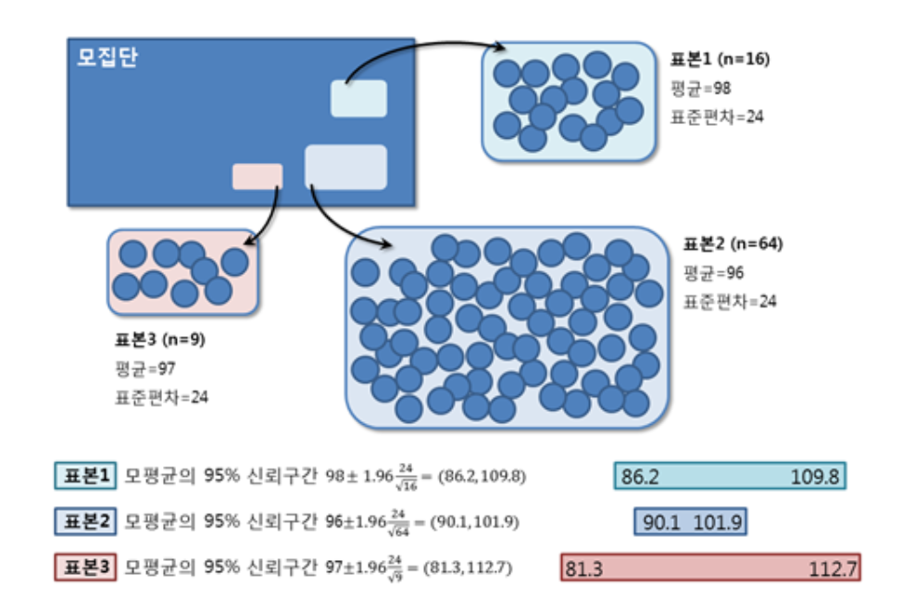
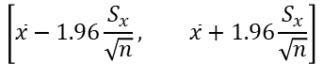
Long Short-Term Memory Recurrent Neural Network for Remaining Useful Life Prediction of Lithium-Ion Batteries
Results and discussion
RUL Prediction Without Offline Training Data (cell 1)
Error
$$failuer real value−predicted failuer$$
95% confidence interval
50%
70%
$$\left[\overline{x}−1.96\frac{S_{x}}{\sqrt{n}}, \overline{x}+1.96\frac{S_{x}}{\sqrt{n}}\right]$$
506
C-rate : if 1 C → 1h (discharging/charging)
$S_{x}$ : standard deviation
95% confidence interval

Slide 18
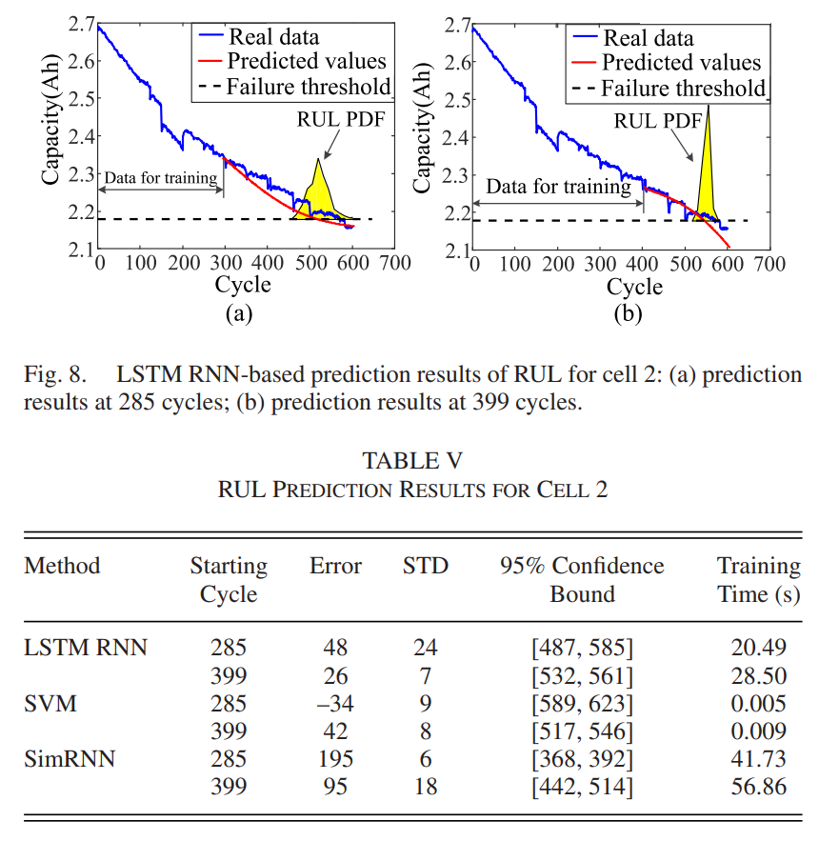
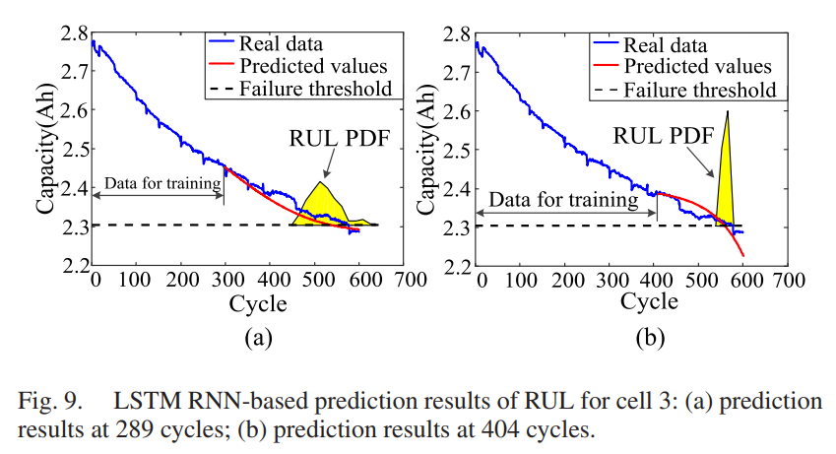
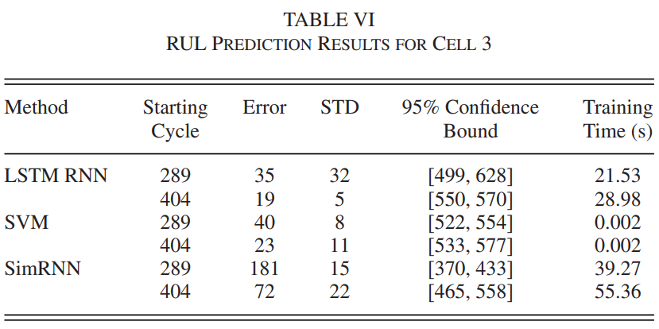
Long Short-Term Memory Recurrent Neural Network for Remaining Useful Life Prediction of Lithium-Ion Batteries
Results and discussion
RUL Prediction Without Offline Training Data (cell 2, 3)
50%
70%
50%
70%
571
578

Slide 19
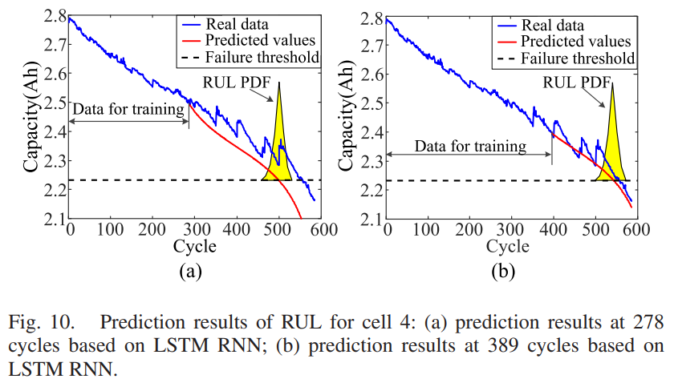
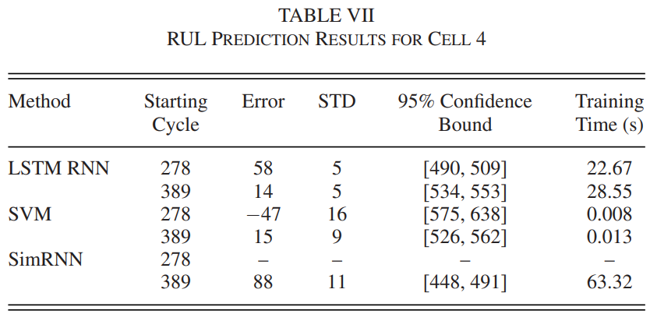
Long Short-Term Memory Recurrent Neural Network for Remaining Useful Life Prediction of Lithium-Ion Batteries
Results and discussion
RUL Prediction Without Offline Training Data (cell 4)
50%
70%
500
557

Slide 20
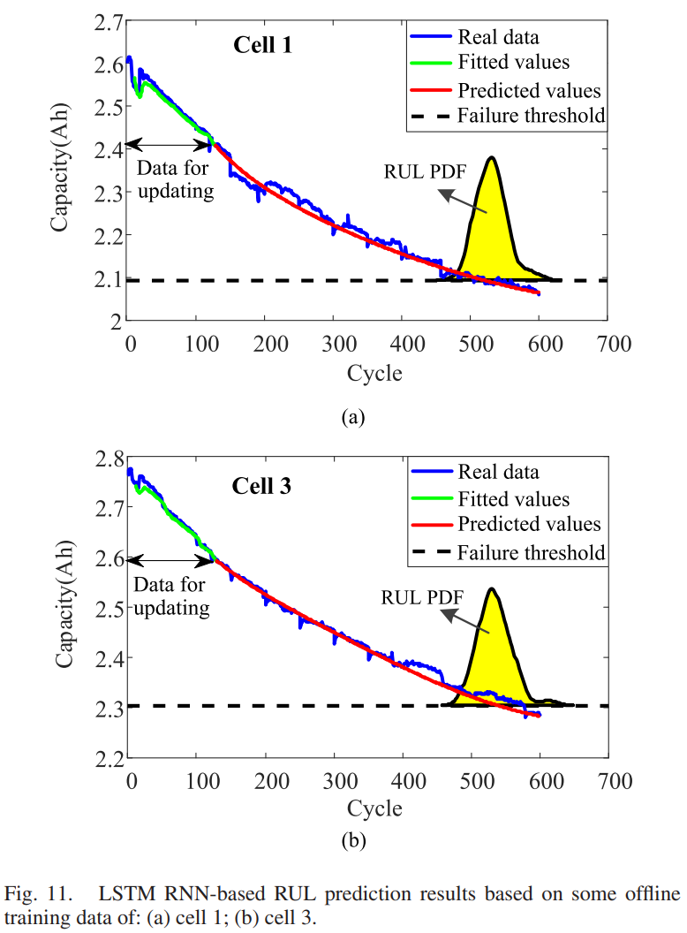
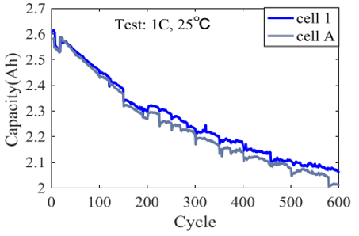
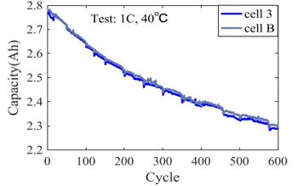
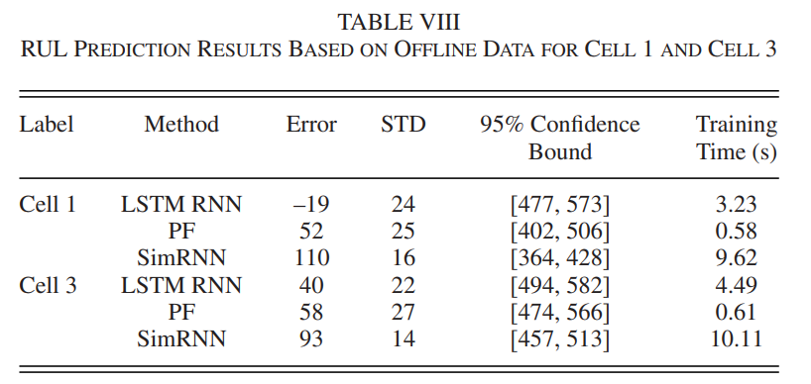
Long Short-Term Memory Recurrent Neural Network for Remaining Useful Life Prediction of Lithium-Ion Batteries
Results and discussion
RUL Prediction With Some Offline Training Data
the offline data should be collected under similar working conditions to those of online cells
20 ~ 25 %
525
20 ~ 25 %
500

Slide 21
Long Short-Term Memory Recurrent Neural Network for Remaining Useful Life Prediction of Lithium-Ion Batteries
Conclusions
The challenge of RUL prediction for lithium-ion batteries lies in how to accurately learn the long-term dependencies over hundreds of cycles based on limited degradation data.
LSTM (long-term dependencies) + RMSprop (optimizer) + dropout (overfitting) + Monte Carlo simulation (uncertainties)
The constructed LSTM RNN can be used to predict the battery RUL independent of offline training data.

Slide 22
Decentralized Plug-in Electric Vehicle Charging Selection Algorithm in Power Systems
Reference
Unit Tests for Stochastic Optimization
Understanding RMSprop — faster neural network learning
95% confidence interval
Monte Carlo Simulation An In-depth Tutorial with Python

